Slide 1
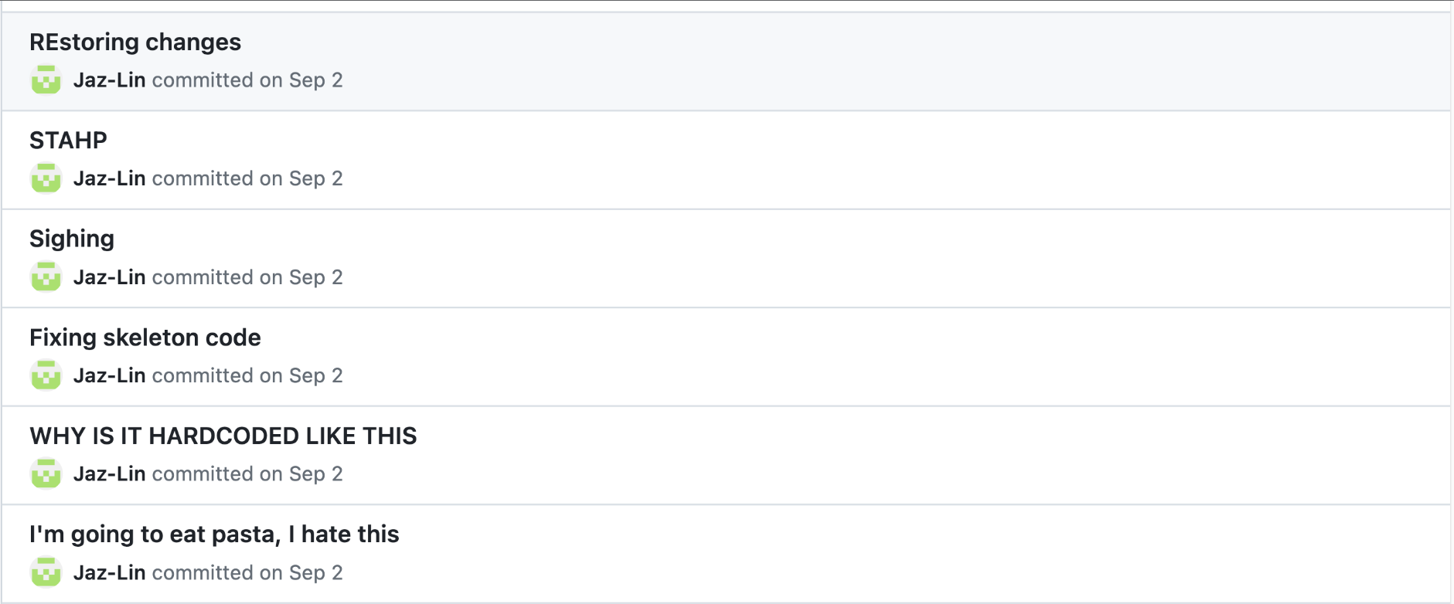
Software Engineering III
Lecture 33
CS61B, Fall 2023 @ UC Berkeley
Notes:
Pasta tasted bad :(

Slide 2
Background
Background
Git Recap
Snapshots
SHA-1
Remote
Git Potpourri
Break
Dynamic Programming
Example
Applications and Continuation
Q&A
Lecture 33, CS61B, Fall 2023

Slide 3

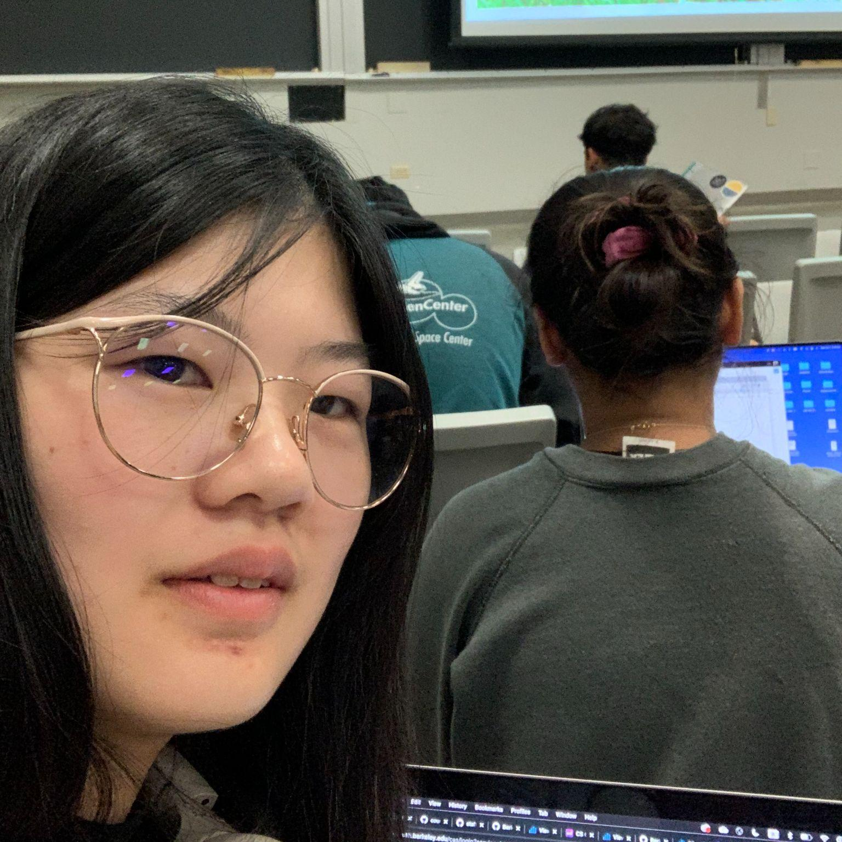
Background
Eric Che (he/him)
Jasmine Lin (she/her)
Senior majoring in CS
2nd sem on staff, also taught 170 and 61C
salted butter > unsalted butter
Senior majoring in CS + DS
5th Semester on course staff (CS61B + CS61BL)
unsalted butter > salted butter

Slide 4
Today’s lecture will be split into two topics:
Git
Dynamic Programming
We’ll have a general Q&A at the end for both parts.

Slide 5
Git Recap
Background
Git Recap
Snapshots
SHA-1
Remote
Git Potpourri
Break
Dynamic Programming
Example
Applications and Continuation
Q&A
Lecture 33, CS61B, Fall 2023

Slide 6
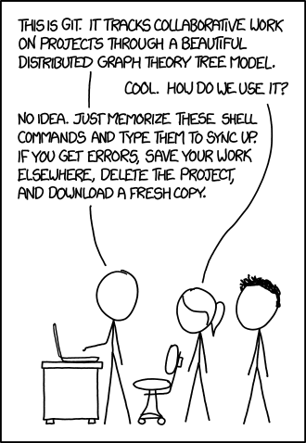
Goals
Understand how git works behind the layer of abstraction.
Git is not easy to think of as an abstraction.
It’s possible to memorize commands, but things will most likely go wrong.
Learn data model and later cover the command line interface (CLI)
Commands can be better understood in terms of how they manipulate the underlying data model.
Proper Git usage for collaboration on Proj 3
Git is a useful tool and not a hindrance
https://xkcd.com/1597/

Slide 7


Git vs GitHub
git - particular implementation of Version Control (There are other version control systems like: SVN, version control for hardware designs, etc)
GitHub - online service for distributing git repos through web and provides GUI/features for using git
Easily view commits, edit code online, manage who can see your repo
Git is software you use locally to record version control.
GitHub is a hosting service. Theoretically, you can put all of your git projects into google drive or send to email, but GitHub is nicer.

Slide 8
Snapshots
Background
Git Recap
Snapshots
SHA-1
Remote
Git Potpourri
Break
Dynamic Programming
Example
Applications and Continuation
Q&A
Lecture 33, CS61B, Fall 2023

Slide 9
Snapshots
A snapshot represents how a repo looks at a particular point of time.
Eg: Working on Project 3 with partner
You save commits over time to show progress
Partner can understand code in smaller commit chunks
If you mess up, you can always revisit back.
But then, how do we work on two snapshots simultaneously?
Initial Commit
Make Rooms
Make Hallway
Make Walls

Slide 10
Relating Snapshots
How do you have concurrent development?
Branches
Allow more than one pointer to a previous commit
Work on multiple features in parallel
main branch is considered the default branch.
Merge
A snapshot that combines multiple snapshots
Merge history back together into a single branch
The underlying data structure is a Directed Acyclic Graph!
Initial Commit
Make Rooms
Make Hallway
Make Walls
Merge
main
Fix Overlap Rooms
Start Inter-
activity
branch1

Slide 11
Relating Snapshots
A commit is a snapshot of your project with additional metadata identifying the commit.
class Commit {
Project snapshot;
Set<Commit> parents; // Root is empty set, Merge has size > 1
String author;
String commitMessage;
}
Initial Commit
Make Rooms
Make Hallway
Make Walls
Merge
main
Fix Overlap Rooms
Start Inter-
activity
branch1

Slide 12
SHA-1
Background
Git Recap
Snapshots
SHA-1
Remote
Git Potpourri
Break
Dynamic Programming
Example
Applications and Continuation
Q&A
Lecture 33, CS61B, Fall 2023

Slide 13
The SHA (Secure Hashing Algorithm)
SHA1 is an implementation of a hashCode function.
(Mostly) Collision-Free: Cannot easily find two different objects with the same hash because SHA1 (used to be) is secure
Quickly determine if two objects are identical by comparing hash
Interesting git blog to see what happens if there’s a collision
Consistent: The same content stored in two repositories will always be stored under the same hash
Corrupted file checking is easily detected
The hash of corrupted content does not match its name.
Examples (try with http://www.sha1-online.com/):
1 -> 356a192b7913b04c54574d18c28d46e6395428ab
2 -> da4b9237bacccdf19c0760cab7aec4a8359010b0
3 -> 77de68daecd823babbb58edb1c8e14d7106e83bb

Slide 14
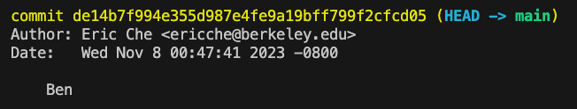
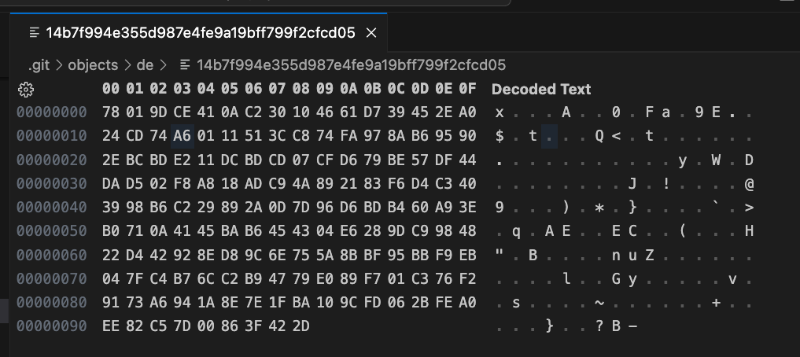
Content Addressing
In git, each file, folder, and commit is addressed by their SHA-1 hash.
In git log, SHA1 is the long jargon for each commit
All objects can be quickly identified by their hash.
git status uses the SHA1 to quickly identify modified files
Do not need to store duplicate files in each snapshot. Just store hash.
Quickly reference commits with hash
All objects are stored in .git > objects

Slide 15
Remote
Background
Git Recap
Snapshots
SHA-1
Remote
Git Potpourri
Break
Dynamic Programming
Example
Applications and Continuation
Q&A
Lecture 33, CS61B, Fall 2023

Slide 16
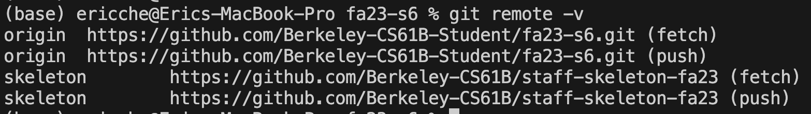
Remote
To communicate with the outside world, git uses remote repositories.
Remote manages repositories which you can push or pull changes into.
git remote add <branch> <URL>: add a connection to a remote repository
git fetch: downloads commits and files from a remote repo into your local repo.
git push: upload local repository content to a remote repository
We use remotes in CS61B
origin (fa23-s***): private student repository that we push changes into
git push origin main
skeleton (skeleton-fa23): repository that we pull new assignments from
git pull skeleton main

Slide 17
CS61B Remote Example
git pull skeleton main # FYI: git pull is a fetch + merge
git commit -m “Finish Proj 0”
git pull skeleton main
git commit -m “Finish Proj 1”
Initial Commit
Merge
Finish Proj 0
Merge
Finish Proj 1
origin
Create Proj 0
Create Proj 1
skeleton

Slide 18
Introducing Git Rebase
git rebase <branch>: moves commits from a branch to a new base commit
Solves same problem as merge (add changes from different branches)
Cleaner project history
Eliminates the unnecessary merge commits
Downside: This means true history is lost since we moved the commit
git pull skeleton main --rebase
git commit -m “Finish Proj 0”
git pull skeleton main --rebase
git commit -m “Finish Proj 1”
Initial Commit
Create Proj 0
Finish Proj 0
Create Proj 1
Finish Proj 1
origin

Slide 19
Merge Conflict Example
Group Repo on Github
Initial Commit
origin
Student 1 Local
Student 2 Local
origin
origin

Slide 20
Merge Conflict Example
Group Repo on Github
Initial Commit
origin
Student 1 Local
Student 2 Local
git pull origin main
git pull origin main
git pull origin main
Initial Commit
Initial Commit
origin
origin

Slide 21
Merge Conflict Example
Group Repo on Github
Initial Commit
origin
Student 1 Local
Student 2 Local
git commit -m “Add Hello”
git commit -m “Add World”
Initial Commit
Hello
Initial Commit
World
origin
origin
System.out.println(“Hello”)
System.out.println(“World”)

Slide 22
Merge Conflict Example
Group Repo on Github
Initial Commit
Hello
origin
Student 1 Local
Student 2 Local
git push origin main
Initial Commit
Hello
Initial Commit
World
origin
origin

Slide 23
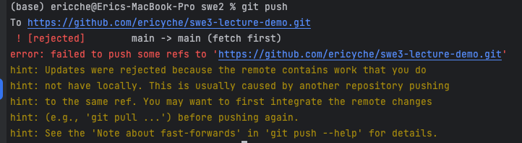
Merge Conflict Example
Group Repo on Github
Initial Commit
Hello
origin
Student 1 Local
Student 2 Local
git push origin main
Initial Commit
Hello
Initial Commit
World
origin
origin

Slide 24
Merge Conflict Example
Group Repo on Github
Initial Commit
Hello
origin
Student 1 Local
Student 2 Local
git pull origin main
Initial Commit
World
Initial Commit
World
merge
origin
origin
Hello

Slide 25
Merge Conflict Example
Group Repo on Github
Initial Commit
World
merge
origin
Hello
Student 1 Local
Student 2 Local
git push origin main
Initial Commit
Hello
Initial Commit
World
merge
origin
origin
Hello

Slide 26
Merge Conflicts
There are new <<<<, ====, >>>> lines!
The ======= line is the "center" of the conflict.
Content above the ======= exists in the current branch.
Content below the ======= exists in our merging branch.
Usually, it makes sense to keep both if both partners are working on different things!
Don’t forget to commit!
git commit -m "Merge and resolve conflicts!"
<<<<<<< HEAD
System.out.println(“World”)
=======
System.out.println(“Hello”)
>>>>>>> d80eec051e8e5eeae1f41a3
System.out.println(“Hello”)
System.out.println(“World”)

Slide 27
Git Potpourri
Background
Git Recap
Snapshots
SHA-1
Remote
Git Potpourri
Break
Dynamic Programming
Example
Applications and Continuation
Q&A
Lecture 33, CS61B, Fall 2023

Slide 28
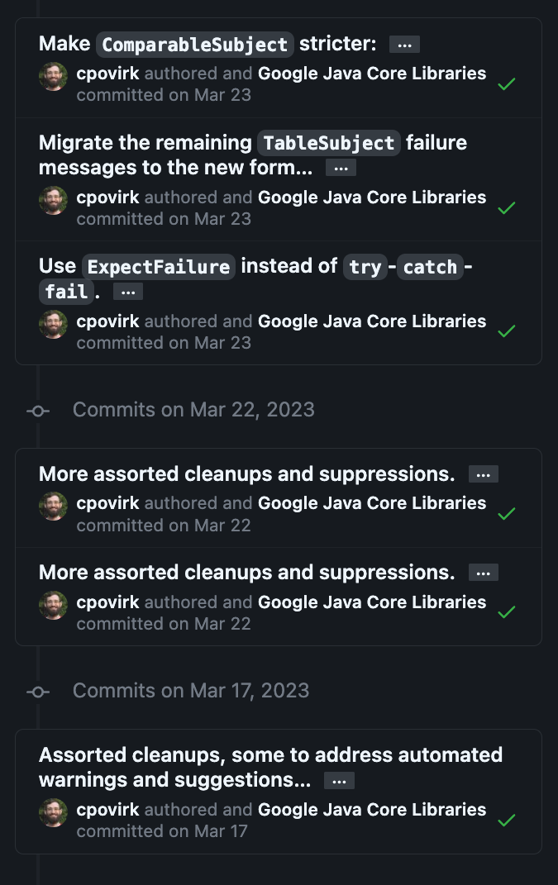
Writing Good Git Commits
There are well-established conventions:
Capitalize the subject line
Use imperative mood in the subject line
If applied, this commit will <subject line here>
Use the body to explain what and why vs how
code is self-explanatory
If it is complex, add source comments
Limit subject line to 50 characters (soft rule)
Ensures that commits are readable
If you hard time summarizing, you might be committing too many changes at once.
Rules: https://cbea.ms/git-commit/
Example: Google Truth Library (We use for writing tests!)

Slide 29
Writing Good Git Commits
Good Commit Messages:
Add room generation logic
Fix overlapping rooms
Make world generation tests
Document world generation algorithm
Start persistence logic
Refactor persistence logic to use RandomUtils
Reformat game homepage text to use more whitespace
Rearrange buttons so OK is on the lower right
Revise link to update it to the new URL

Slide 30
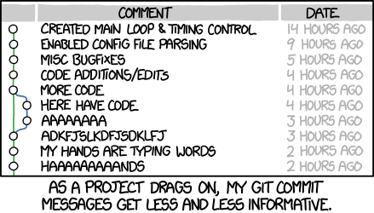
Bad Commit Messages
https://xkcd.com/1296/

Slide 31
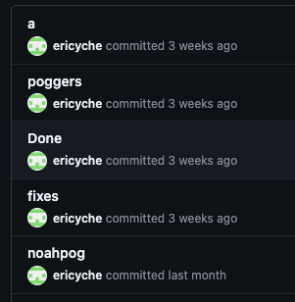
Bad Commit Message

Slide 32
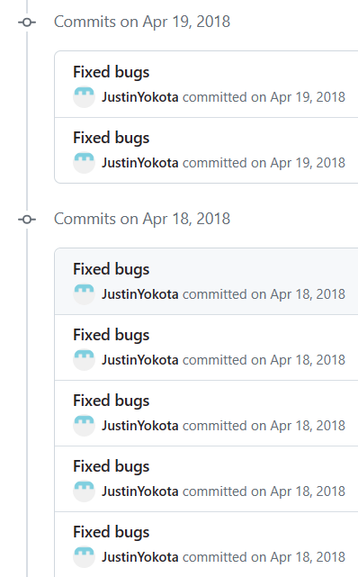

Justin’s Bad Commit Message

Slide 33
Git Commands Extras
git diff
Show changes between commits or in current working copy
git blame
Examine a file line by line and see when each line was last modified and who the author of the modifications was
E.g. Who you blame for a bug
git stash
Stash changes in a dirty working directory away
Want to pull changes from remote but don’t want to make a commit yet
git commit --amend
amend the most recent commit so you don’t make a new commit
git rebase -i
Interactive rebasing session
Allows you to rebase, add, edit, or delete commits along the way if you want to modify history

Slide 34
Break
Background
Git Recap
Snapshots
SHA-1
Remote
Git Potpourri
Break
Dynamic Programming
Example
Applications and Continuation
Q&A
Lecture 33, CS61B, Fall 2023

Slide 35
Dynamic Programming
Background
Git Recap
Snapshots
SHA-1
Remote
Git Potpourri
Break
Dynamic Programming
Example
Applications and Continuation
Q&A
Lecture 33, CS61B, Fall 2023

Slide 36
Dynamic Programming (CS170 Preview)
What is dynamic programming?

Slide 37
Dynamic Programming (CS170 Preview)
Dynamic programming: a programming technique or algorithmic pattern where a problem can be solved by breaking it down into smaller subproblems.
We can use the answers to the smaller subproblems to solve for the larger ones until the whole problem is solved.

Slide 38
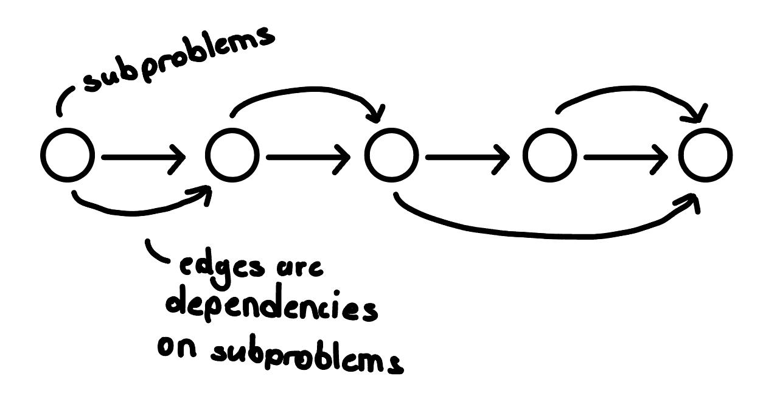
Dynamic Programming (CS170 Preview)
Dynamic programming: a programming technique or algorithmic pattern where a problem can be solved by breaking it down into smaller subproblems.
We can use the answers to the smaller subproblems to solve for the larger ones until the whole problem is solved.
Conceptually, this algorithmic process can be thought of as a DAG (directed acyclic graph).

Slide 39
Optimization Technique
Dynamic programming is ultimately an optimization technique - the first step to applying it is to recognize if a problem can be solved with DP.
If you’re trying to solve a problem, can you break it down in more “bite-sized” pieces?
From here, you want to consider the following:
What’s the base case (i.e. what’s the smallest subproblem)?
What’s the recurrence relation? This describes the relationship between the subproblems and how an optimal solution can be solved with the smaller subproblems.

Slide 40
Example
Background
Git Recap
Snapshots
SHA-1
Remote
Git Potpourri
Break
Dynamic Programming
Example
Applications and Continuation
Q&A
Lecture 33, CS61B, Fall 2023

Slide 41
Example: Planting Trees
Let’s try building up a dynamic programming algorithm:
Let’s say we have a garden with n adjacent spots, numbered 1 to n.
Each tree needs a space to grow, so if we plant a tree in the ith spot, we can’t plant a tree in spots i - 1 or i + 1.
Problem: What is the maximum number of ways that we can plant our trees in the garden?
🌳
1
2
3
4
5
6
If we plant a tree at spot 3, then we can’t plant a tree in spot 2 or 4.
Notes:
Source: Inspired by https://drive.google.com/file/d/1ssmVtL-SxBfCXTmLydKp9u5KeRIsJjhG/view (Fall 2023 Discussion 7)

Slide 42
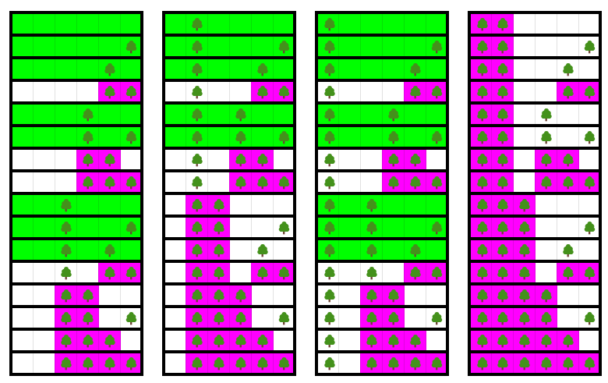
Example: Planting Trees
Naive Solution:
We can try considering all the possible tree arrangements and count the valid arrangements.
At each spot, we have two choices: don’t plant or plant. Going through all combinations would lead to 2 * 2 * 2… * 2, where we multiply N times.
This leads to a time complexity of Θ(2^{N})
Notes:
Source: Inspired by https://drive.google.com/file/d/1ssmVtL-SxBfCXTmLydKp9u5KeRIsJjhG/view (Fall 2023 Discussion 7)

Slide 43
Example: Planting Trees
Instead, let’s break it down into smaller subproblems. Let’s define f as a function that counts the number of tree arrangements based on the input size of N, representing the number of spots we have in the garden.
Planting at spot 0 would have 1 valid way (no trees planted). So f(0) = 1.
How many valid ways are there for f(1)?
Notes:
Source: Inspired by https://drive.google.com/file/d/1ssmVtL-SxBfCXTmLydKp9u5KeRIsJjhG/view (Fall 2023 Discussion 7)
The planting trees problem is slightly different from what I was planning actually; the premise is similar, but instead of maximizing score, we just want to count how many distinct ways we can plant the trees. This has a naive solution: check all possible tree arrangements, and count the valid ones. That takes Θ(2^N) time to run.
11:46
Alternatively, we try to break it down to smaller problems; we either plant a tree in spot 0 (in which case we have f(N-2) options for the rest of the garden), or don't plant a tree in spot 0 (in which case we have f(N-1) options for the rest of the garden) (where f is the function in question we want to solve).
11:47
Therefore, the DP method of solving this reveals that the function fulfills the recurrence relation f(N)=f(N-1)+f(N-2).
11:48
At which point you go through solving fib

Slide 44
Example: Planting Trees
Instead, let’s break it down into smaller subproblems. Let’s define f as a function that counts the number of tree arrangements based on the input size of N, representing the number of spots we have in the garden.
Planting at spot 0 would have 1 valid way (no trees planted). So f(0) = 1.
How many valid ways are there for f(1)? f(1) = 2
So, if we decide to plant at spot i using spots from 1 to i, we can break it down into two scenarios:
If we plant at spot i, then we have f(i-2) options remaining
If we don’t plant at spot i, then we have f(i-1) options remaining
Since we want to count the number of total number of valid tree arrangements, our recurrence relation can be defined as f(i) = f(i-1) + f(i-2)
Notes:
Source: Inspired by https://drive.google.com/file/d/1ssmVtL-SxBfCXTmLydKp9u5KeRIsJjhG/view (Fall 2023 Discussion 7)

Slide 45
Example: Fibonacci Sequence
The Fibonacci sequence is a sequence where each number is the sum of the two preceding ones. For this example, let’s assume that the sequence starts from 0 and 1.
So, the Fibonacci sequence is as below:
0, 1, 1, 2, 3, 5, 8, 13, 21, 34, 55, 89, 144…
Notice that the nth value is based on the sum of the two preceding values, except for the 0th and 1st value in the sequence.

Slide 46
Example: Fibonacci Sequence
Taking this sequence:
0, 1, 1, 2, 3, 5, 8, 13, 21, 34, 55, 89, 144…
We can define a relationship like below for the nth term of the Fibonacci sequence:
Base Case:

Slide 47
Example: Fibonacci Sequence
Taking this sequence:
0, 1, 1, 2, 3, 5, 8, 13, 21, 34, 55, 89, 144…
We can define a relationship like below for the nth term of the Fibonacci sequence:
Base Case:
fib(0) = 0; fib(1) = 1
// The base case for the earlier problem starts 2 terms later in the Fibonacci sequence, so f(n) == fib(n+2).
Recurrence Relation:

Slide 48
Example: Fibonacci Sequence
Taking this sequence:
0, 1, 1, 2, 3, 5, 8, 13, 21, 34, 55, 89, 144…
We can define a relationship like below for the nth term of the Fibonacci sequence:
Base Case:
fib(0) = 0; fib(1) = 1
// The base case for the earlier problem starts 2 terms later in the Fibonacci sequence, so f(n) == fib(n+2).
Recurrence Relation:
fib(N) = fib(N - 1) + fib(N - 2)
// The tree counting then reduces to Fibonacci.

Slide 49
Example: Fibonacci Sequence
If we want to define a function that finds the nth term of the Fibonacci sequence, how would we start?

Slide 50
Example: Fibonacci Sequence
We might start out with a (naive) recursive approach, as the recurrence relation we defined earlier lends itself to this approach:
Base Case:
fib(0) = 0; fib(1) = 1
Recurrence Relation:
fib(N) = fib(N - 1) + fib(N - 2)

Slide 51
Example: Fibonacci Sequence
public int fib(int N) {
if (N <= 1) {
return N;
}
return fib(N - 1) + fib(N - 2);
}
(Naive) Recursive Approach

Slide 52
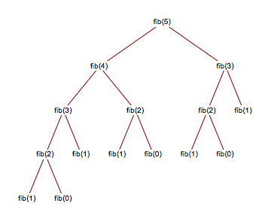
Example: Fibonacci Sequence
Notes:
Source: https://javascript.plainenglish.io/fibonacci-javascript-implementations-comparison-fd09190f5b79

Slide 53
Example: Fibonacci Sequence
When we solve it recursively, notice that we don’t save any of the intermediate values; that is we need to re-compute subproblems each time. This results in the following time and space complexity:

Slide 54
Example: Fibonacci Sequence
When we solve it recursively, notice that we don’t save any of the intermediate values; that is we need to re-compute subproblems each time. This results in the following time and space complexity:
Time Complexity: Ω(2^{N/2})
In reality Θ(φ^{N}), where φ = (sqrt(5)+1)/2)~1.618
Space Complexity: Θ(N)
This is to account for the maximum size of the stack (i.e. amount of memory needed for recursive calls).
How can we optimize this more?

Slide 55
Example: Fibonacci Sequence
Let’s take this further with dynamic programming. Let’s also add a few more details:
To reiterate, a recursive function is recursive if it calls itself during execution.
Dynamic programming can be implemented with or without recursion, but at its core, DP takes advantage of using those subproblems to solve the larger one. More explicitly, we should try to reuse those solutions to the subproblems to solve for the problem as a whole.

Slide 56
Example: Fibonacci Sequence
public int fib(int N) {
if (N <= 1) {
return N;
}
// track solutions to subproblems
int[] dp = new int[N + 1];
dp[1] = 1;
for (int i = 2; i <= N; i++) {
dp[i] = dp[i - 1] + dp[i - 2];
}
return dp[N];
}
Add a little spice called Dynamic Programming

Slide 57
Example: Fibonacci Sequence
With dynamic programming, we optimize the problem a little more so that we save the results from smaller subproblems and use it to solve for larger ones (until the entire problem is solved). This results in the following time complexity and space complexity:
Time Complexity: Θ(N)
Space Complexity: Θ(N)
Proportional to the size of the array

Slide 58
Example: Fibonacci Sequence
With dynamic programming, we optimize the problem a little more so that we save the results from smaller subproblems and use it to solve for larger ones (until the entire problem is solved). This results in the following time complexity and space complexity:
Time Complexity: Θ(N)
Space Complexity: Θ(N)
Proportional to the size of the array
**We can also optimize this even further to constant space complexity if we just track the two preceding terms in two variables.
The approach we talk about in this case is bottom-up with tabulation (store results of subproblems in a table).

Slide 59
Bottom-Up Approach
In this approach, a problem can be solved from the “bottom-up”, where we use the smaller subproblems first to solve for the larger subproblems. In order to use these subproblems, we have to store them in some kind of data structure, but we effectively work our way up towards solving the larger problem.

Slide 60
Top-Down Approach
Similarly to bottom-up, we also still want to use the subproblems to solve for the larger problems, but we don’t start from the “bottom”, but instead, start from the “top”. For example, the top-down approach for the earlier problem (Fibonacci sequence), would save the results from the subproblems for later use.

Slide 61
Top-Down Approach
This is really just recursion with memoization (storing the results of function calls).
Notes:
Source:https://javascript.plainenglish.io/fibonacci-javascript-implementations-comparison-fd09190f5b79

Slide 62
Top-Down Approach
private Map<Integer, Integer> memo = new HashMap<>();
public int fib(int N) {
if (memo.containsKey(N)) {
return memo.get(N);
}
int result = fib(N - 1) + fib(N - 2);
memo.put(N, result);
return memo.get(N);
}

Slide 63
Tree-Planting, Fibonacci and Dynamic Programming Summary
To provide a brief summary:
The tree counting problem can be reduced down into the fibonacci sequence.
From there, we use dynamic programming to optimize our approach to the problem.
Naive runtime: Θ(2^{Ν})
After DP: Θ(N)

Slide 64
Applications and Continuation
Background
Git Recap
Snapshots
SHA-1
Remote
Git Potpourri
Break
Dynamic Programming
Example
Applications and Continuation
Q&A
Lecture 33, CS61B, Fall 2023

Slide 65
More Examples
There are also more problems that can be solved through dynamic programming. Here a couple of more of them:
Longest increasing subsequence: given a sequence of integers, what is the longest increase subsequence that can be found
Edit Distance: the minimum number of edits (insertions, deletions, substitutions of a character) to transform one word into another
Knapsack: resource allocation (more details here)
And of course, a lot more than the ones that are mentioned here.

Slide 66
More Examples
Another cool algorithm that uses dynamic programming:
Bellman-Ford: finds the shortest path from a source vertice to the other vertice
The main difference between this algorithm and Dijkstra’s is that it can handle negative edge weights by detecting cycles with negative edge weights
Caveat: the runtime of this algorithm is O(V*E) for connected graphs

Slide 67
Applications of Dynamic Programming
Dynamic programming has several applications:
Graph theory
Traveling Salesman
Game Theory
Justin’s Master’s thesis :O (link)
AI and Machine Learning
Bioinformatics
DNA strings can be quickly analyzed for similarity using DP
Tech Interviews
And more (research paper on some applications of DP)
If you want to practice more with dynamic programming, you can find some problems on Project Euler.

Slide 68
CS170
This topic is covered more in-depth in CS170, and if you’re more broadly interested in efficient algorithms, it might be a course to consider taking in the future.
The corresponding notes for dynamic programming from CS170 can be found here if you’re interested in reading more: https://people.eecs.berkeley.edu/~vazirani/algorithms/chap6.pdf
(They’re very good!)

Slide 69
Lab 12
While this is not required (and out-of-scope), one of those methods that you’ll need to implement for lab 12, clearLines, can be solved using dynamic programming.
If you want an extra challenge on this week’s lab, see if you can apply DP!

Slide 70
Q&A
Background
Git Recap
Snapshots
SHA-1
Remote
Git Potpourri
Break
Dynamic Programming
Example
Applications and Continuation
Q&A
Lecture 33, CS61B, Fall 2023

